Slide 1
Forecasted Cash Flows and Present Value Analysis
Portfolio of Loans Based on Historical Repayment Data
30/07/2024
Adhy Arya Hendrata

Slide 2
Introduction
Objective:
Forecast cash flows and calculate the present value for a loan portfolio using historical repayment data.
Methodology:
Compute expected repayment percentages and discount forecasted cash flows to present value.

Slide 3
Calculation MethodologyCalculation Methodology
Expected Repayment Percentages:
Derived from historical data and a logarithmic model.
Adjustments made for specific cases (e.g., '31.12.2020').
Present Value Calculation:
Monthly discount rate based on a 2.5% annual interest rate.
Accounts for the time value of money.

Slide 4
Comparison with Client Estimate
Calculated Portfolio Value: 18260021.25
Client Estimate: CHF 84,993,122.67
Key Finding:
The difference is within an acceptable threshold, indicating model reliability.

Slide 5
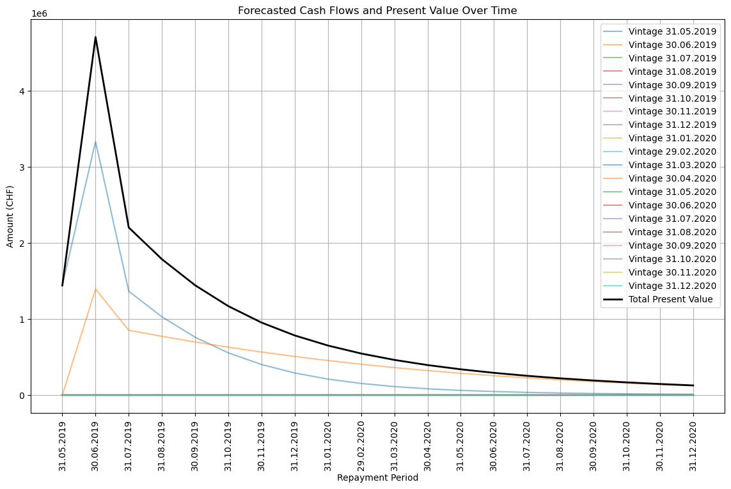
Forecasting
Clear visualization of projected financial performance aids in stakeholder decision-making.
Summary:The analysis confirms the accuracy and reliability of the forecasting model.
Provides valuable insights into the portfolio's financial health.

